Slide 1
Creating an area-level deprivation index and using a dashboard tool to communicate information about the index – a public health informatics workshop
Module 1: Input, data selection, and extraction for developing the Ohio Children’s Opportunity Index (OCOI)
W13
Presenter- Priti Singh , PhD, MS
Authors: Naleef Fareed, PhD, MBA; Priti Singh, PhD, MS; Ian Dunn MS, GISP;
Pallavi Jonnalagadda, DrPh, MBBS; Christine Swoboda, PhD., MS
Institution : The Ohio State University

Slide 2
Disclosure
I and my spouse/partner have no relevant relationships with commercial interests to disclose.

Slide 3
Learning Objectives
After participating in this session you will be:
1. Familiar with the decisions involved in data selection and extraction to construct an area-level index of opportunity.
2. Construct a multi-year area-level index of opportunity using R Studio and R Markdown.

Slide 4
Introduction: OCOI
SDoH
Health and Health care
Social and community context
Education
Economic Stability
Neighborhood and
built environment
The OCOI is an area-level measure indicating the opportunity for development and well-being in children based on neighborhood factors or social determinants of health (SDoH).
A variety of individual measures must be chosen to reflect the different facets of SDoH which are then combined into an overall score for a specific area.¹
The purpose of the OCOI is to provide a measure of children opportunity in Ohio.
Source: Healthy People 2020, https://www.healthypeople.gov/2020/topics-objectives/topic/ social-determinants-of-health

Slide 5
Data Selection
Using the framework developed by Townsend (1987),² the current study adopted a multi-dimensional or in this case, a multi-domain approach.
Measures of social determinants of children’s health and well-being selected from literature review and international examples.³⁻⁴
Secondary data were collected from federal and state agencies.⁵⁻¹¹
These domains were made up of 53 constituent measures.

Slide 6
Domains and constituent measures of OCOI
Housing
Child Health
Family Stability
Environment
Education
Access
Infant Health
Criminal Justice
Labor Market Engagement Index
% of children living in a household with below-poverty income
% of children no paternity at birth
% of parents enrolled in MDCD with a primary SMI diagnosis
% of parents enrolled in MDCD with a primary SUD diagnosis
Low transportation cost index
Distance to supermarket
% Housing units without vehicle
Child BH visits meeting CMS Standards.
Child PCP visits meeting CMS Standards
Geographic Isolation
Distance to nearest elementary school
Severe housing cost burden (>50 of Income)
% households w/ >1 person/room
% putting 50 percent of income towards rent
% Population renting
% tract pop not living in same housing unit for >=1yr
% housing units identified as vacant
Eviction rate among renters
Avg. Daily particulate matter
Retail outlets within a 3/4 mile buffered tract boundary
Env. Haz. Index (Air Quality)
% of land area not covered by vegetation.
% of land area covered by open development.
% of housing units constructed prior to 1980 (lead exposure).
Infant mortality rate
Pre-term birth rate
% NICU stay
% NAS
Six or more Well Child visits
% born to MDCD women with severe maternal morbidity
% MDCD infants with injury or poisoning in first year of life
Age 1-5 MDCD with dev. delay
Age 3-6 meeting continuous enrollment PCP
Age 6-17 MDCD with asthma
Age 6-17 MDCD with diabetes
Age 6-17 MDCD with obesity
Age 6-17 MDCD with MI
Age 6-17 MDCD with dev. disability
Age 6-17 MDCD received psychotropic medication
HS dropout rates
% of adults with HS education
% of youth (5-17) not enrolled in school
% of children DNM 3rd grade reading standards
Free lunch Distribution
Graduation Rate
School Perf. Index
School’s Value Add
Homicide, aggravated assault and sexual assault
Robbery incidents
Burglary, larceny-theft, and motor vehicle theft
Public DUI and drunkenness
Drug-related crime incidents

Slide 7
Data Collection
• Information on deprivation was collected to form the area-level deprivation index (ADI) and reversed to represent opportunity or OCOI
• SDoH information was collected across various sources and linked using census tracts
• Study data were collected across 2,952 census tracts in Ohio
• Information was gathered across 2013-2017 time period across multiple sources and linked using census-tracts
2021 Clinical Informatics Conference | amia.org

Slide 8
Module 2: Construction of OCOI
Presenter- Priti Singh, PhD, MS
2021 Clinical Informatics Conference | amia.org

Slide 9
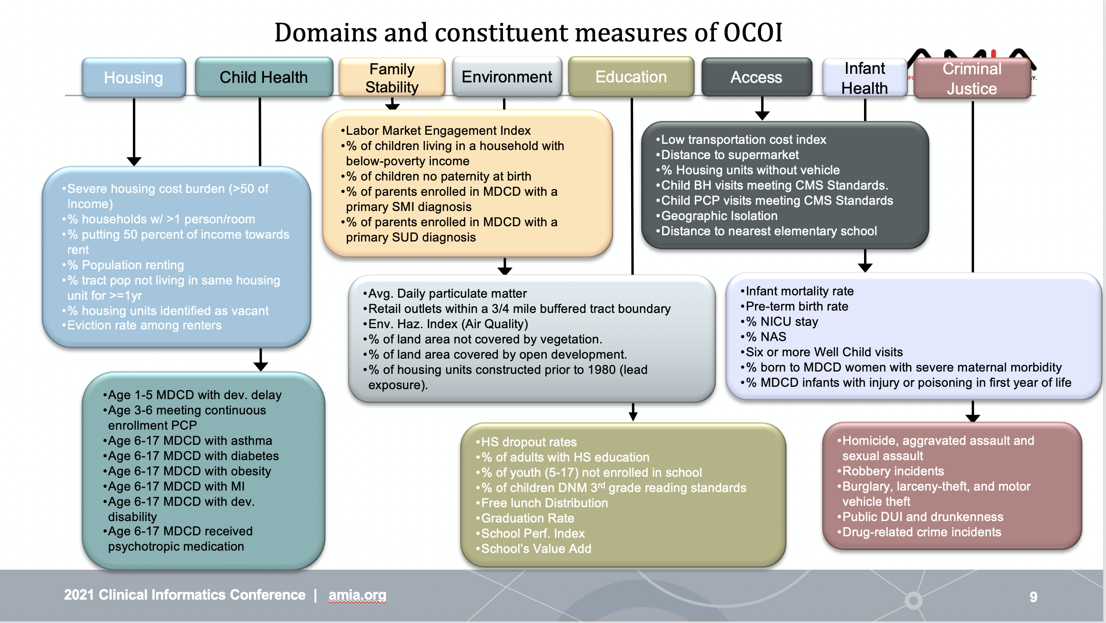

Slide 10
Data Preparation
Type of data
Directionality of responses
Missing values
Tracts with zero population (twelve tracts)
2021 Clinical Informatics Conference | amia.org

Slide 11
OCOI Construction
The 53 constituent measures used in the study were summarized to form the domain scores which were then summarized to form the OCOI.^{1,2} The steps involved in the OCOI construction are outlined as follows:
• Standardization of the constituent measures (transform to z-scores)
• Averaging the standardized measures within each domain (Create domains)
• Ranking and re-scaling scores within each domain
• Exponential transformation of the track-ranked values of each domain-average
• Constructing the OCOI using either of the two approaches:
• A confirmatory factor analysis (CFA) approach with one latent factor loading on each domain score
• Equal weighting approach

Slide 12
Histogram of ADI and OCOI
Figure 2: Histogram of ADI (left) and OCOI(right)
2021 Clinical Informatics Conference | amia.org

Slide 13
OCOI descriptive statistics
Table 1. Summary of Ohio Children’s Opportunity Index scores and domains
 | Median | Mean | Standard Deviation | Minimum | 1st Quartile | 3rd Quartile | Maximum
OCOI | 79.35 | 74.82 | 17.00 | 0.00 | 65.64 | 87.84 | 100
Septile 1 | 44.01 | 42.49 | 9.50 | 0.00 | 37.10 | 49.99 | 54.30
Septile 2 | 62.59 | 62.01 | 4.20 | 54.31 | 58.27 | 65.62 | 68.41
Septile 3 | 72.47 | 72.50 | 2.31 | 68.42 | 70.47 | 74.48 | 76.32
Septile 4 | 79.35 | 79.23 | 1.64 | 76.32 | 77.78 | 80.50 | 82.12
Septile 5 | 84.50 | 84.53 | 1.37 | 82.12 | 83.40 | 84.57 | 86.73
Septile 6 | 88.85 | 88.90 | 1.26 | 86.73 | 87.83 | 89.92 | 91.09
Septile 7 | 93.68 | 94.10 | 2.10 | 91.1 | 92.34 | 95.56 | 100
2021 Clinical Informatics Conference | amia.org

Slide 14
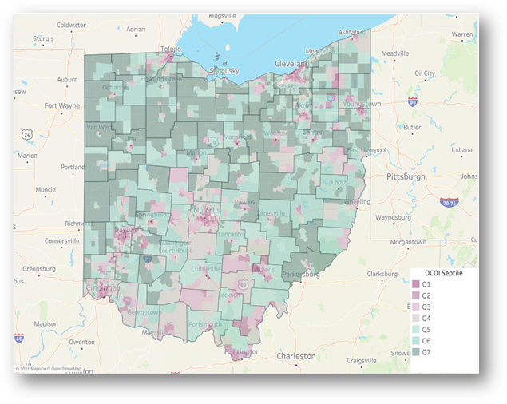
OCOI scores on a choropleth map of Ohio
Toledo
Cleveland
Columbus
Cincinnati
2021 Clinical Informatics Conference | amia.org

Slide 15
Validation
OCOI scores were used as predictors for health-related outcomes and racial groups
The average life expectancy of children born in septile 7 was approximately 9 years more than those born in septile 1 (p<0.001).
The percentage of Black population living in septile 7 was 48 points lesser than those in septile 1. Likewise, the percentage of Minority population living in septile 7 was 54 points lesser than septile 1. Trend test results were significant across all three outcomes (p<0.001).

Slide 16
Discussion & Conclusion
This is the first children’s opportunity index developed for the state of Ohio
The OCOI was created to codify the geographic distribution of SDoH in the state of Ohio, particularly those that are likely to impact infants and children.
Increases in the OCOI scores were associated with higher life expectancy and the distribution of minority communities in census tracts.
The OCOI has potential for improvements that may further enhance its ability to communicate deprivation information.

Slide 17
Thank you!!!

Slide 18
References
1.Noble M, Wright G, Smith G, Dibben C. Measuring multiple deprivation at the small-area level. Environ Plann A. 2006;38(1):169-185. doi:10.1068/a37168
2. Townsend P. Deprivation. J Soc Policy. 1987;16(02):125-146. doi:10.1017/S0047279400020341
3. Townsend P, Phillimore P, Beattie A. Health and Deprivation : Inequality and the North. London: Croom Helm; 1988
4. Aber JL, Bennett NG, Conley DC, Li J. The effects of poverty on child health and development. Annu Rev Public Health. 1997;18:463-483. doi:10.1146/annurev.publhealth.18.1.463
5. Larson K, Halfon N. Family income gradients in the health and health care access of US children. Matern Child Health J. 2010;14(3):332-342. doi:10.1007/s10995-009-0477-y
6. U.S. Census Bureau. Population Estimates. 2017.
7. Tudor HJ. The inverse care law. Lancet. 1971.
8. Fiscella K, Shin P. The inverse care law: implications for healthcare of vulnerable populations. J Ambul Care Manage. 2005;28(4):304-312. doi:10.1097/00004479-200510000-00005
9. Dixon-Woods M, Cavers D, Agarwal S, et al. Conducting a critical interpretive synthesis of the literature on access to healthcare by vulnerable groups. BMC Med Res Methodol. 2006;6:35. doi:10.1186/1471-2288-6-35
10. Ely DM, Driscoll AK. Infant mortality in the united states, 2018: data from the period linked birth/infant death file. Natl Vital Stat Rep. 2020;69(7):1-18.
11. Fareed N, Swoboda CM, Jonnalagadda P, Griesenbrock T, Gureddygari HR, Aldrich A. Visualizing Opportunity Index Data Using a Dashboard Application: A Tool to Communicate Infant Mortality-Based Area Deprivation Index Information. Appl Clin Inform. 2020;11(4):515-527. doi:10.1055/s-0040-1714249

Slide 19
Thank you!
Email me at: [optional]

